Slide 1
Insight into the WNBA
March 6, 2025
By Tasleem M

Slide 2

Agenda
Introduction
Known Assumptions
Organization History Dashboard
Game Stat Analysis
Game Attendance
Player Popularity
Marketing and Merchandise
Summary

Slide 3
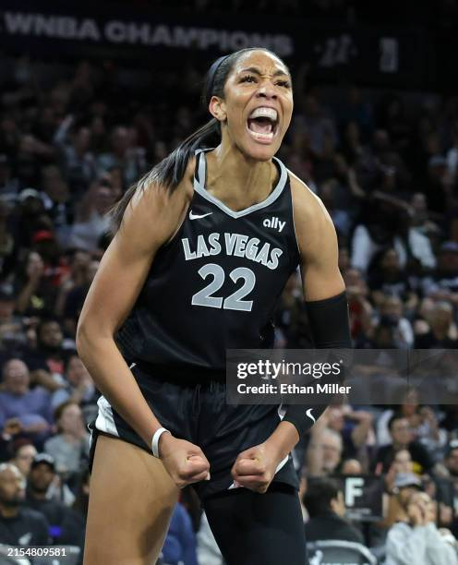
Introduction
WNBA is an organization that has been undervalued for a large part of its history. Its sharp increase in mainstream popularity in recent years introduces a question of if the momentum towards the sport will continue to grow or if this is their “15 min of fame” due to specific factors.
Is it the gameplay?
Is it the players?
Is it TikTok?

Slide 4

Known Assumptions
Sport fans enjoy competitive games with skillful players.
Watching a competitive team brings positive feelings and a sense of pride, encouraging people to become more invested in the team.
Player or team success increases media attention, making it easier for new fans to discover and engage with the team.
Fluctuations in game statistics per season are due to several factors such as injury, player trades and release, etc.

Slide 5

Organization History Dashboard

Slide 6
The power of competition
A Game Stat Analysis (2010 - 2024)

Slide 7
Top 5 Teams
Are the metrics correlated with playoff success?
Team | # of Top 5 Appearances | Playoff Appearances
Minnesota Lynx | 6 of 7 metrics | 13 of 15
Connecticut Sun | 5 of 7 metrics | 10 of 15
Seattle Storm | 5 of 7 metrics | 12 of 15
Los Angeles Sparks | 4 of 7 metrics | 10 of 15
Atlanta Dream | 3 of 7 metrics | 9 of 15
Phoenix Mercury | 3 of 7 metrics | 13 of 15
Indiana Fever | 2 of 7 metrics | 8 of 15
Chicago Sky | 2 of 7 metrics | 9 of 15
New York Liberty | 2 of 7 metrics | 10 of 15
Las Vegas Aces | 2 of 7 metrics | 10 of 15
Washington Mystics | 1 of 7 metrics | 10 of 15

Slide 8
Game Attendance dashboard

Slide 9
Player Popularity of 2024 Draft Picks
Indiana Fever & First-Time All-Star Selection Player – Caitlin Clark
Set WNBA records for most assists both in a season (337) and in a game (19)
Recorded the first two triple-doubles by a rookie in league history
Established single-season rookie records for points (769) and three-pointers made (122)
19 of 22 games that reached 1 million views featured Caitlin Clark
Fever games averaged 1.19 million viewers this regular season, 199% better than 394,000 for other games
Chicago Sky & First-Time All-Star Selection Player – Angel Reese
Averaged WNBA-record 13.1 rebounds per game
Set another league mark with 15 consecutive double-doubles
2024 SEC player of the year
Won the 2023 NCAA women's basketball championship with LSU
Named the Most Outstanding Player (MOP) for the NCAA championship tournament

Slide 10
Marketing and Merchandise
WNBA merchandise sales both online at WNBAStore.com and the flagship location in New York City were up a combined 601% from 2023
Merchandise sales at Dick’s Sporting Goods increased by 233% compared to last season
Set a single-season record with nearly 2 billion video views across its social media platforms, more than quadruple last season’s total (378 million)
WNBA App monthly active users grew by 252% compared to last season
WNBA League Pass, the league’s out-of-market live game package, experienced a 366% growth in subscriptions versus last season

Slide 11
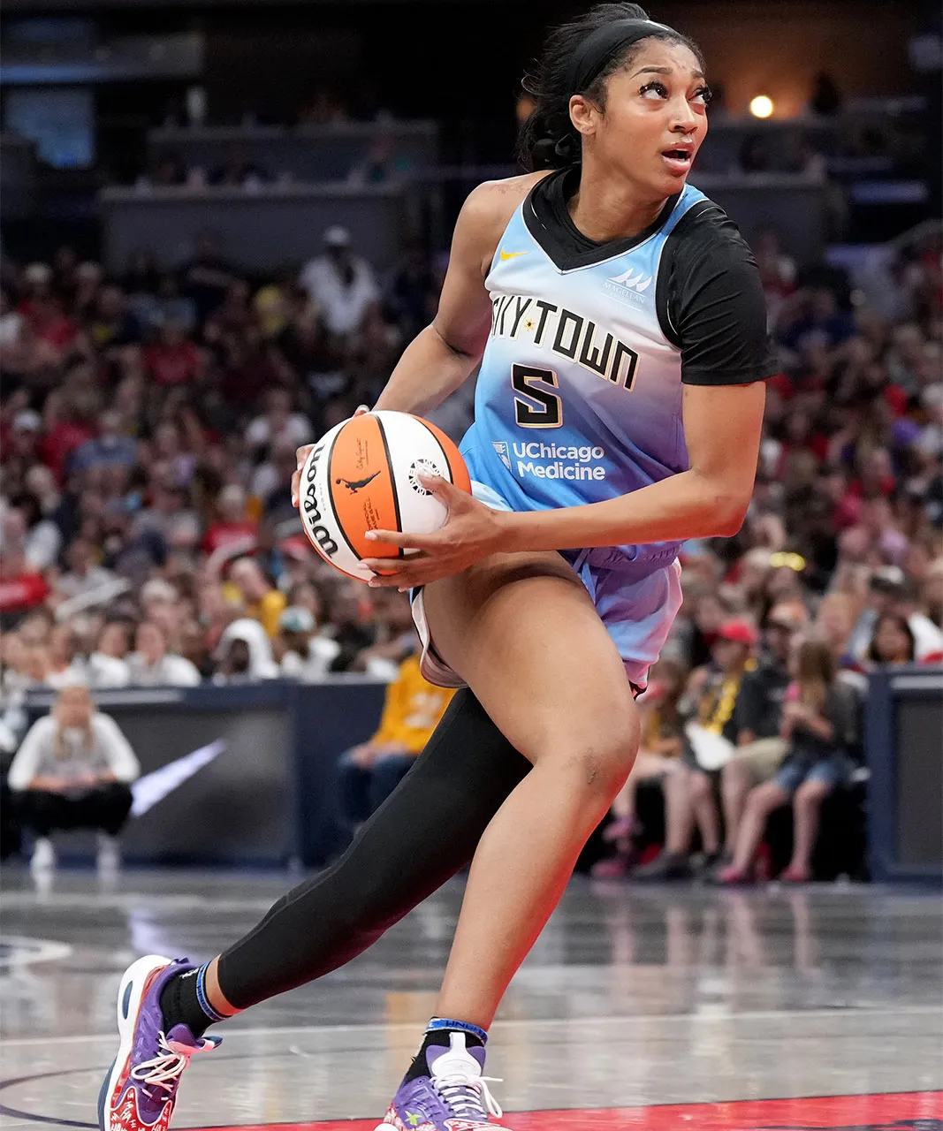
Summary
In recent years, the WNBA has experienced historic growth within the sport. So, what is contributing to its success and what can we expect in the future?
Analysis of game statistics and attendance suggests player popularity plays a large part in fan interaction. While competitive teams encourage fan investment, popular players engrosses a higher amount of involvement.
Developing and making use of popular players will greatly contribute to the WNBA’s continued success.

Slide 12

Thank you
Tasleem M
trmuhammad2017@gmail.com
Linkedin.com/in/tasleem-m

